Slide 1

Mastering Python Sets and Dictionaries
Essential Data Structures for Efficient Data Management and Programming

Slide 2

Introduction to Python Sets and Dictionaries
2
01
Understanding Python Sets
02
Exploring Python Dictionaries
Sets are unordered collections that store unique elements, ensuring no duplicates.
They are ideal for operations like union, intersection, and difference.
Dictionaries organize data as key-value pairs, allowing fast access and intuitive data management.
They are perfect for scenarios where data needs to be labeled or categorized.
03
Importance in Python Programming
Both sets and dictionaries are essential for writing clean, effective Python code.
They provide powerful tools to manage collections of data efficiently.
Mastering Python Sets and Dictionaries

Slide 3

What Are Sets?
3
Definition of Sets
Use Case: Unique User IDs
Sets are collections of unique items without any specific order.
They automatically eliminate duplicates, making them ideal when uniqueness is important.
Sets can represent unique user IDs in a system.
This ensures no repeated entries and maintains data integrity.
Use Case: Tags in Systems
Importance of Uniqueness
Sets are useful for managing tags in a system.
They prevent duplication and ensure each tag is unique.
Sets are essential when uniqueness is a priority.
They simplify processes by automatically removing duplicates.
Mastering Python Sets and Dictionaries

Slide 4
Creating and Modifying Sets
4
Creating a Set
Adding an Element
Removing an Element
Creating a set in Python is straightforward.
Example: `my_set = {1, 2, 3}` creates a set with three elements.
To add an element to a set, use the `add` method.
Example: `my_set.add(4)` adds the element 4 to the set.
To remove an element from a set, use the `remove` method.
Example: `my_set.remove(2)` removes the element 2 from the set.
Mastering Python Sets and Dictionaries

Slide 5

Deep Dive into Sets: Key Characteristics
5
Unique Elements and No Order
Fast Membership Tests
Sets store unique elements with no guaranteed order.
This characteristic ensures that duplicate entries are automatically ignored.
Membership tests in sets are very fast due to their structure.
This makes sets ideal for tasks requiring quick checks for element presence.
Immutable Elements
Practical Example of Sets
Elements in sets must be immutable, such as numbers, strings, or tuples.
This restriction ensures the integrity and reliability of the set's contents.
An example of a set in Python is: `unique_numbers = {1, 2, 3, 4}`.
This demonstrates how sets can be used to store unique values efficiently.
Mastering Python Sets and Dictionaries

Slide 6

Common Set Operations
6
Union Operation
Union (|): combines all elements from both sets.
Example: set1 = {1, 2, 3}, set2 = {2, 3, 4}, print(set1 | set2) # Output: {1, 2, 3, 4}
Intersection Operation
Intersection (&): elements common to both sets.
This operation helps identify shared data points between two sets.
Difference Operation
Difference (-): elements in one set but not the other.
It is useful for filtering out elements unique to a specific set.
Symmetric Difference Operation
Symmetric difference (^): elements in either set but not both.
This operation highlights differences between two sets.
Mastering Python Sets and Dictionaries

Slide 7

Practical Use Cases for Sets
7
Removing Duplicates Efficiently
Fast Membership Testing
Sets are highly useful in real-world scenarios: removing duplicates from lists quickly.
This ensures data integrity and simplifies data processing tasks.
Sets allow for fast membership testing for presence checks.
This makes them ideal for scenarios requiring quick lookups.
Mathematical Set Operations
Sets enable performing mathematical set operations in data analysis.
These operations are crucial for comparing and combining datasets effectively.
Mastering Python Sets and Dictionaries

Slide 8

Understanding Dictionaries: Structure and Benefits
8
Key-Value Pair Structure
Example of a Dictionary
Dictionaries store data as key-value pairs, where keys are unique and usually immutable.
Values can be any data type, providing flexibility in data representation.
An example of a dictionary in Python is: `person = {'name': 'Alice', 'age': 30}`.
This demonstrates how data can be organized intuitively using keys and values.
Benefits of Using Dictionaries
Dictionaries allow fast lookups by key, enhancing efficiency in data retrieval.
They are ideal for managing complex information due to their intuitive organization.
Mastering Python Sets and Dictionaries

Slide 9
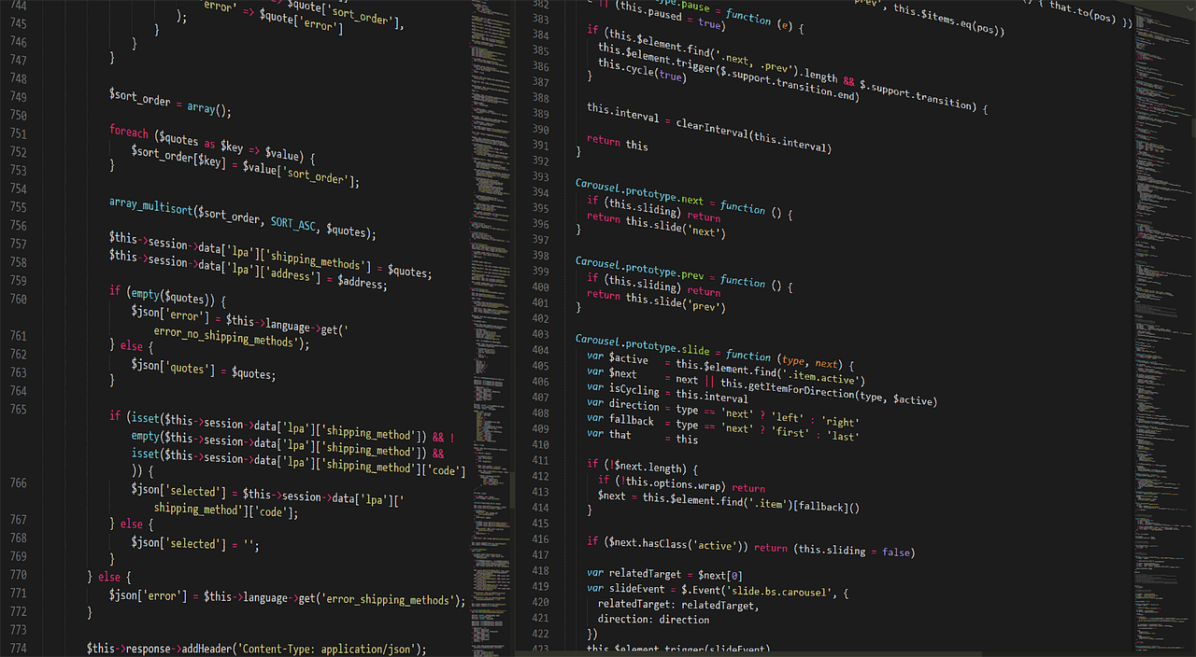
Common Dictionary Manipulations
9
Adding Items to a Dictionary
Essential dictionary operations include adding items.
For example: `person['job'] = 'Engineer'`.
Updating Dictionary Entries
You can update existing items in a dictionary.
For instance: `person['age'] = 31`.
Accessing Dictionary Values
Accessing items in a dictionary is straightforward.
Example: `print(person['name'])`.
Deleting Items from a Dictionary
Deleting items is another key operation.
For example: `del person['age']`.
Mastering Python Sets and Dictionaries

Slide 10
Thank You and Summary
10
Dictionary Comprehensions
Nested Dictionaries
Sophisticated Data Structures
Dictionary comprehensions allow for concise and efficient creation of dictionaries.
For example, `squares = {x: x*x for x in range(5)}` generates a dictionary of squares.
Nested dictionaries enable modeling of complex data structures.
For instance, `person = {'name': 'Bob', 'contacts': {'email': 'bob@example.com', 'phone': '1234'}}` represents a person with contact details.
These dictionary features support the creation of compact and sophisticated data structures.
They are essential for handling and organizing complex datasets effectively.
Mastering Python Sets and Dictionaries

Slide 11

Advanced Dictionary Features
11
Optimal Key Choices
Managing Nested Structures
Use immutable types like strings, numbers, and tuples as keys.
This ensures stability and prevents unexpected behavior in dictionary operations.
Avoid overly large nested dictionaries when possible.
Simpler structures improve readability and reduce computational overhead.
Safe Key Access
Automatic Default Values
Use the get() method for accessing keys safely without errors.
This approach prevents crashes and handles missing keys gracefully.
Consider collections.defaultdict for automatic default values.
This feature simplifies code and avoids manual checks for missing keys.
Mastering Python Sets and Dictionaries

Slide 12
Tips for Optimizing Dictionary Use
12
Understanding Sets
Dictionaries for Key-Value Storage
Sets are unique, unordered collections ideal for data operations requiring uniqueness and fast membership tests.
They are fundamental for tasks like deduplication and efficient data handling in Python.
Dictionaries store key-value pairs, enabling fast lookups and intuitive data organization.
They are essential for managing structured data and implementing mappings in Python.
Pythonic Code Practices
Core Tools for Python Programming
Understanding the operations and use cases of sets and dictionaries helps write clean, Pythonic code.
These practices enhance readability and maintainability in programming projects.
Sets and dictionaries are fundamental tools for effective Python programming.
Mastering them is crucial for leveraging Python's capabilities in data manipulation and organization.
Mastering Python Sets and Dictionaries

Slide 13
Recap and Key Takeaways
13
Understanding Sets
Dictionaries as Key-Value Stores
Writing Effective Python Code
We have explored how sets maintain unique items.
They support operations like union and intersection.
We also examined dictionaries as efficient key-value stores.
These structures are essential for organizing data effectively.
Use these data types to write cleaner, more effective Python code.
Thank you for your attention!
Mastering Python Sets and Dictionaries

